Slide 1
Development of Novel Semiconductor Detectors In Xiantan University
新型半导体粒子、光子探测器的研发
Zheng Li 李正
Xiangtan University, Xiangtan,湘潭大学 Hunan 411105, China
2018.09

Slide 2
OUTLINE
High resistivity Si Detectors
1
研究背景
一
2
Large area Si drift detectors (SDD)
3
3D-Terench-Electrode Detectors
4
Summary

Slide 3
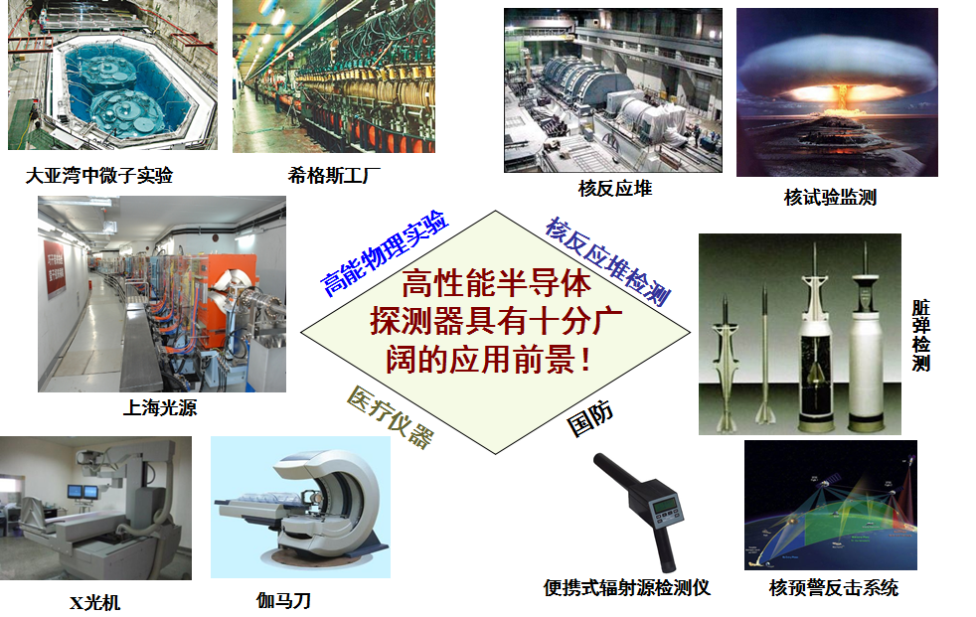
Appication of high resistivity Si Detectors
半导体探测器的应用
Neutrino
Higgs Factory
Nuclear Reactor
Nuclear test monitoring
Light sources
Dirty bomb monotor
X-ray and X-ray Pulsar-based Navigation（XPNAV）
Hand-hold monitor
Nuclear warning

Slide 4
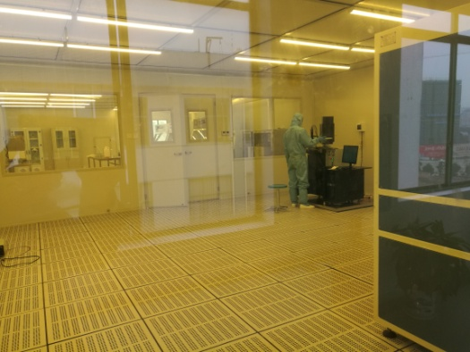
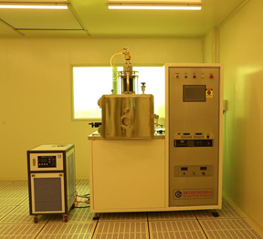
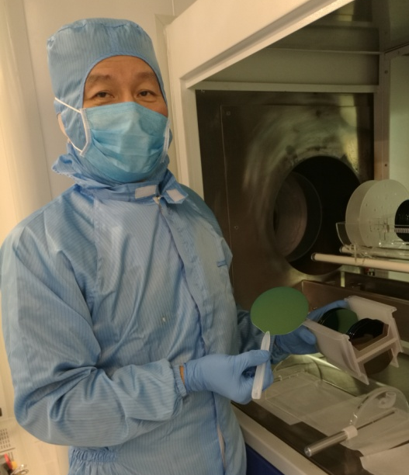
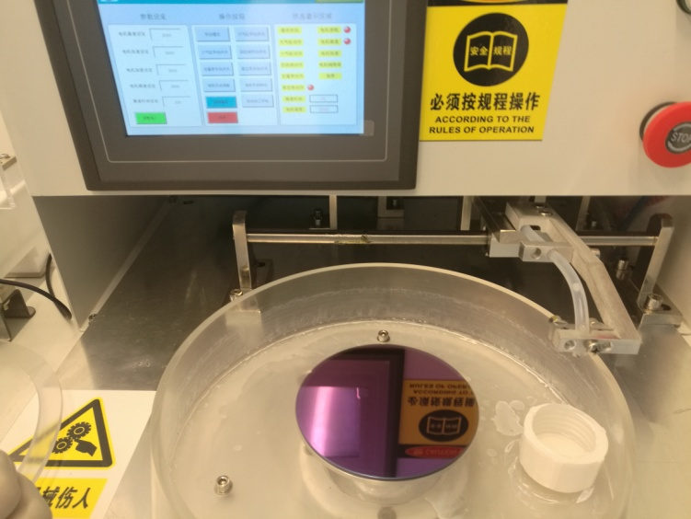
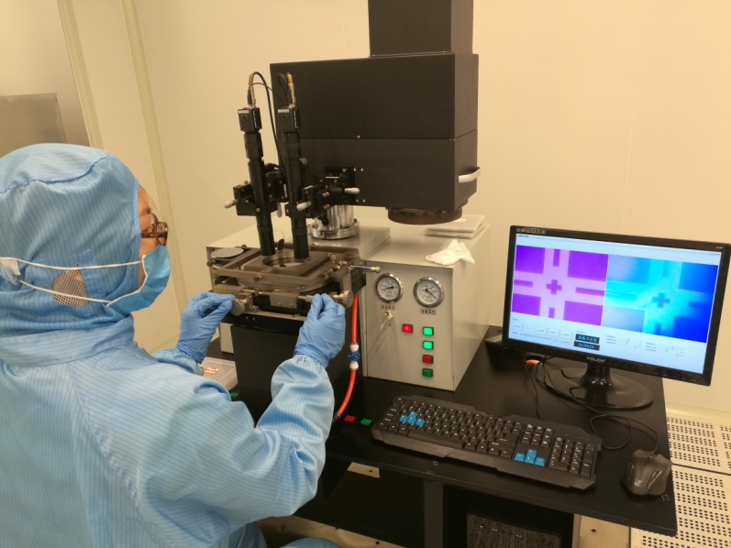
Si detector processing in Xiangtan
百级超净室 (Class-100 Clearnroom，220m²)
双面光刻
DOUBLESIDED-LITHO
氧化 OXIDATION
匀胶 PHOTORESIS

Slide 5
1. High Resistivity Si Detector
Operation Principles
3) e’s and h’s move and separate
in the field to generate signal
Thin entrance window
(thin dead layer) needed for soft X-rays, and ions
d : thickness is hundreds
of μm’s, up to 1mm
Width and length are
up to 100 mm

Slide 6
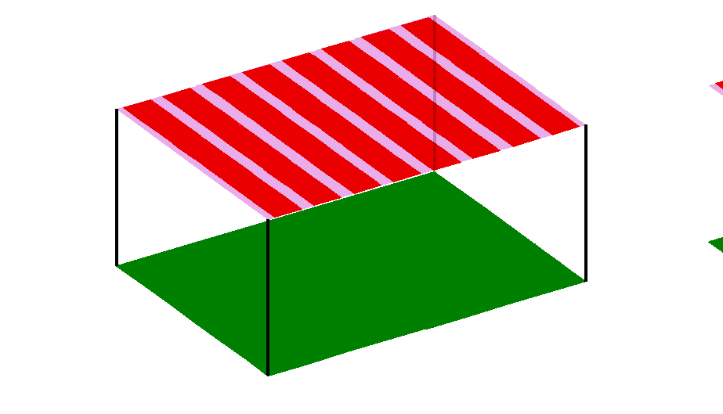
Typical Detector Geometries
Single-side Si Strip Detectors
P (pitch)
L (strip length)
p⁺
n-type Si
d (wafer thickness)
d : up to 1 mm
W : up to 100 mm
L : up to 100 mm
P : down to 50 μm
Total detector volume
V = LWd is active!
n⁺
-
-
-
-
-
-
-
-
W (detector width)
1D-Position sensitivity
hν

Slide 7
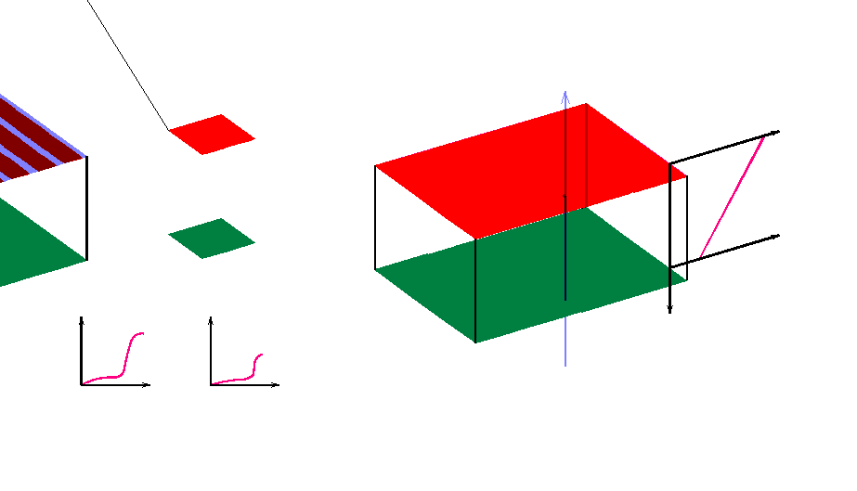
Single-side Si Strip Detectors
1d position sensitivity, single-sided processing
P (pitch)
Q
L (strip length)
p⁺
n-type Si
d (wafer thickness)
d : up to 1 mm
W : up to 100 mm
L : up to 100 mm
P : down to 50 μm
Total detector volume
V = LWd is active!
n⁺
-
-
-
-
-
-
-
-
W (detector width)
1D-Position sensitivity

Slide 8
Double-side Si Strip Detectors
X_{P} (Position of the sensing strip)
0
X (µm)
n-type
≥ 4 kΩ-cm
d = 100 to 600 µm
Y (µm)
MIP
2D-Position sensitivity
Single-metal technology, double-sided litho
V ≥ +100 volts
Y_{P} (Position of the sensing strip)

Slide 9
Double-side Si Strip Detectors
X_{P} (Position of the sensing strip)
0
X (µm)
n-type
≥ 4 kΩ-cm
d = 100 to 600 µm
Y (µm)
2D-Position sensitivity
Single-metal technology, double-sided litho
V ≥ +100 volts
Y_{P} (Position of the sensing strip)

Slide 10
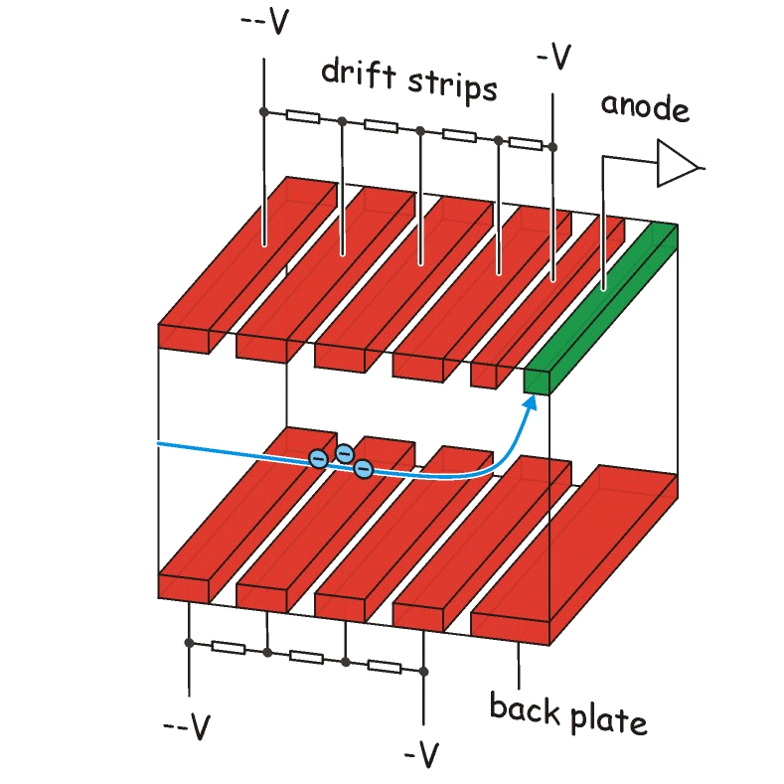
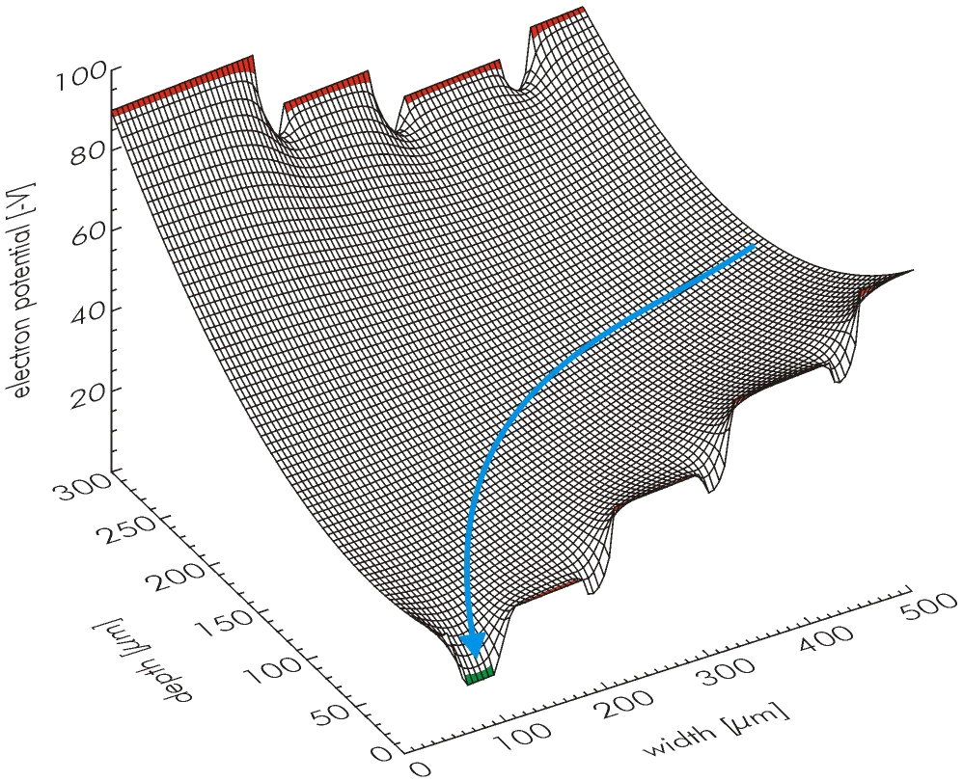
Si Drift Detectors （SDD）
  Operating principle
hν or particle
hν or particle
    mm’s to cm’s
    p⁺
p⁺
n⁺
    250 to
    500 μm
n-type
Si
    p⁺
p⁺
    Anode (n⁺)
Single-metal technology, double-sided litho

Slide 11
Si Drift Detectors （SDD）
  Operating principle
    mm’s to cm’s
Q
    p⁺
p⁺
n⁺
    250 to
    500 μm
n-type
Si
    p⁺
p⁺
    Anode (n⁺)
Single-metal technology, double-sided litho

Slide 12
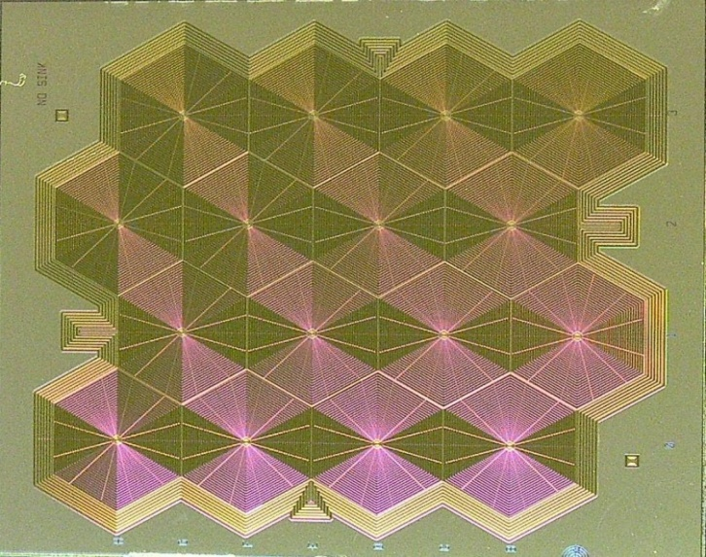
large area detector with a small collection anode
Si Drift Detectors （SDD）
Widely used for X-ray spectroscopy with its low noise (low capacitance (60 fF)).
a)
b)
    Large area SDD array
Excellent energy resolution
Large area detectors
Short shaping: high count rate applications
For photon science and space (NASA lunar mission)
    5 mm
c)
Single-metal technology, double-sided litho

Slide 13
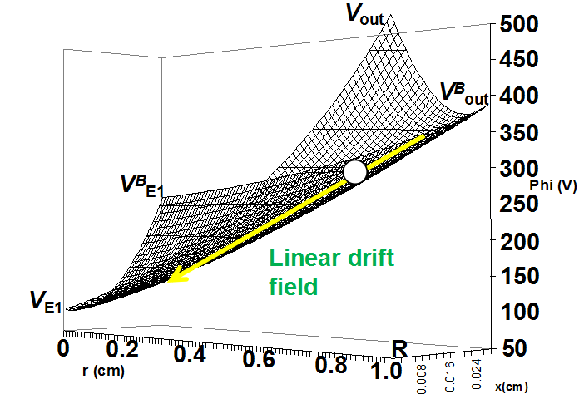

Large area Si Drift Detectors D = 2 cm
  Operating principle
hν or particle
  Conventional
  small area SDD
  with constant
  backside bias

Slide 14
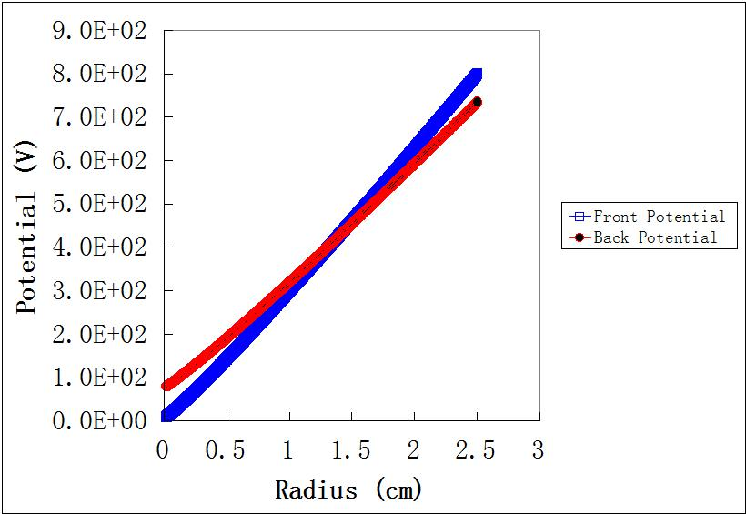
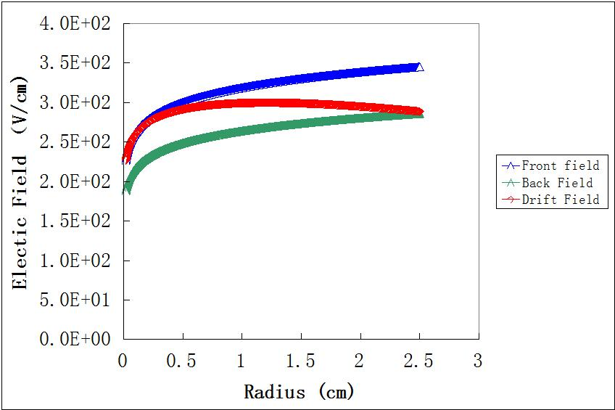
Ultra Large area Si Drift Detectors
Φ= 5 cm (R=2.5cm)， Near constant drift field
Potential distributions
Field distributions
Hexagonal Cell

Slide 15
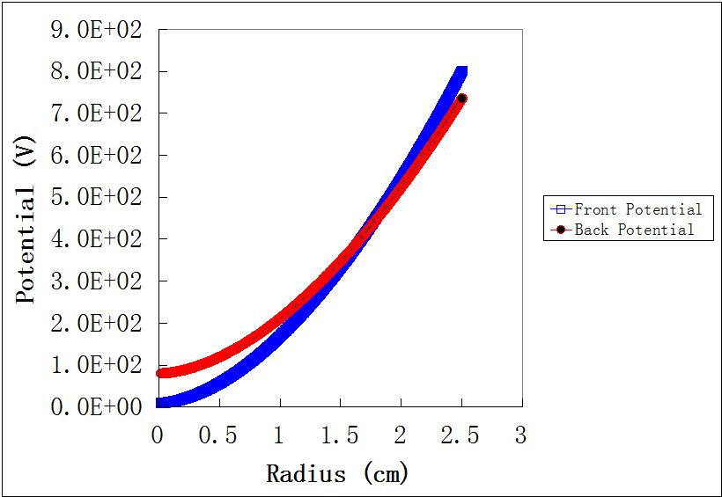
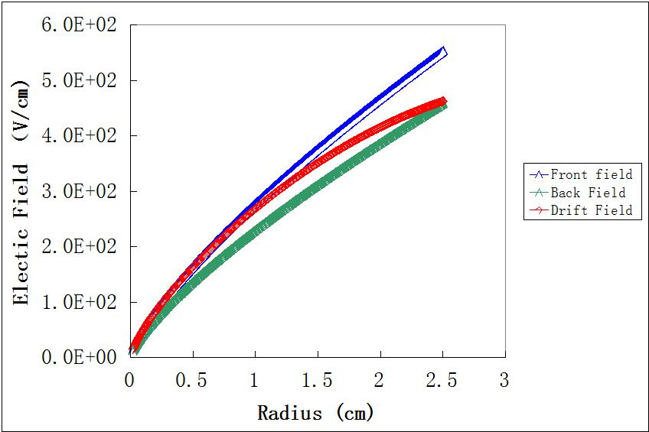
Ultra Large area Si Drift Detectors
Φ= 5 cm (R=2.5cm), Near linear drift field
Potential distributions
Field distributions
Hexagonal Cell

Slide 16
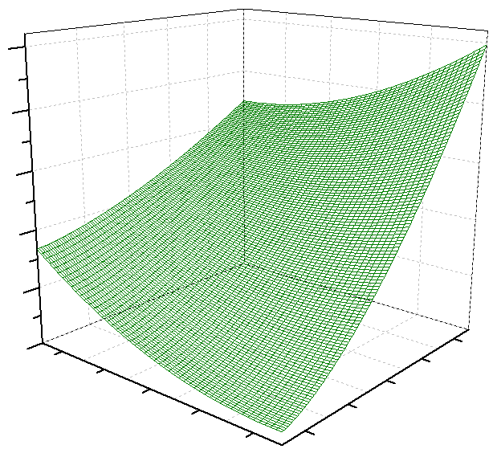
Potential distributions
Phi(r,x) data
m=1, n=4
V_{out}
250
V_{out}=250V
V^{B}_{out}
V_{B,out}=170V
200
ø_{(r,x)} (V)
150
V_{B,E1}=83V
V^{B}
100
50
1.0
0.05
0.9
0.7
0.5
0.025
0.3
r (cm)
x (cm)
0.1
V_{E1}=10V
V_{E1}
0

Slide 17
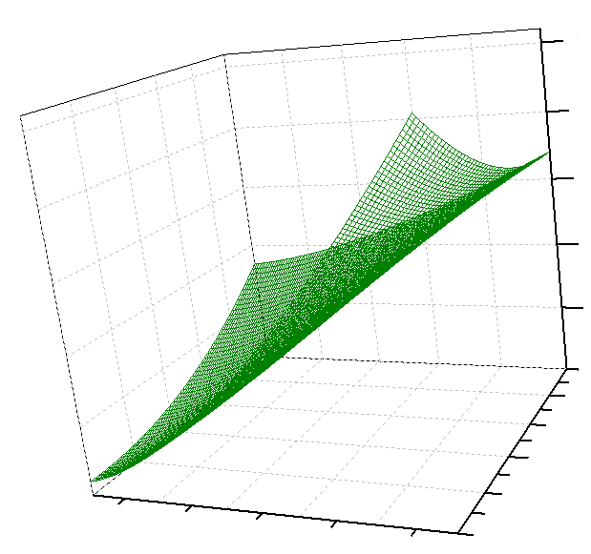
Potential distributions
Phi(r,x) data
m=1, n=4
250
V_{out}
V_{out}=250V
V^{B}_{out}
200
V_{B,out}=170V
V_{B,E1}=83V
150
V^{B}
ø_{(r,x)} (V)
100
50
0.05
0.04
V_{E1}
0.03
V_{E1}=10V
0
0.02
x (cm)
0.3
0.5
0.01
0.7
0.9
r (cm)
1.0

Slide 18
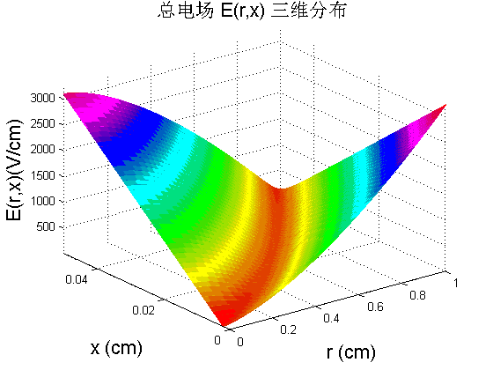
Electric field distribution
V^{B} just right
V_{out} just right
Drift channel is within and pointing to
anode
Anode

Slide 19
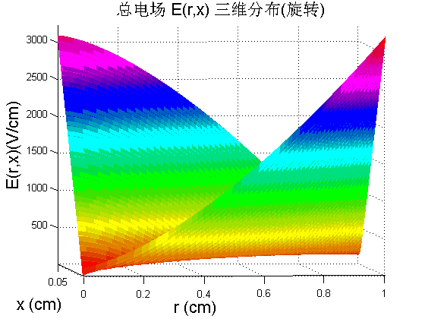
Electric field distribution
V^{B} just right
V_{out} just right
Drift channel is within and pointing to
anode
Anode

Slide 20
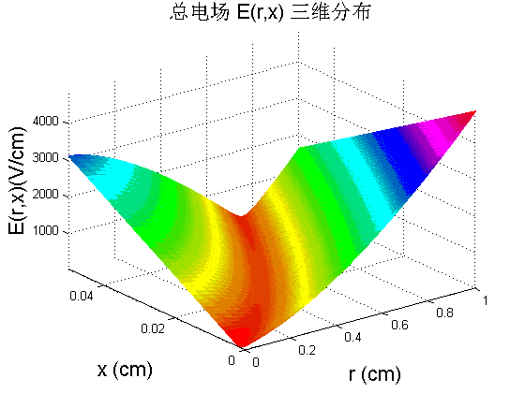
Electric field distribution
V_{out} too large
Drift channel is out
of detector body

Slide 21
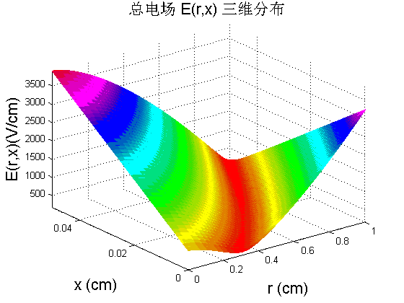
Electric field distribution
V^{B} too large
Drift channel is not pointing to anode
Anode

Slide 22
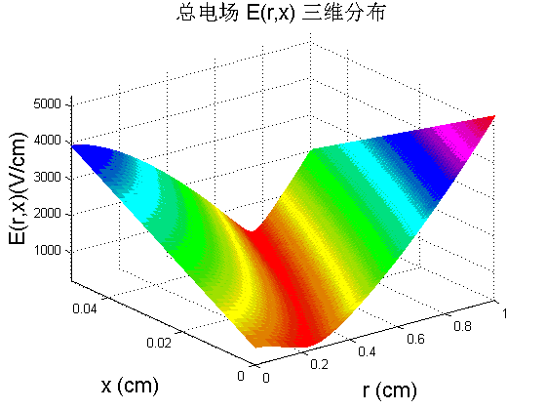
Electric field distribution
Drift channel is out of
detector body and not
pointing to anode
V_{out} too large
V^{B} too large
Anode

Slide 23
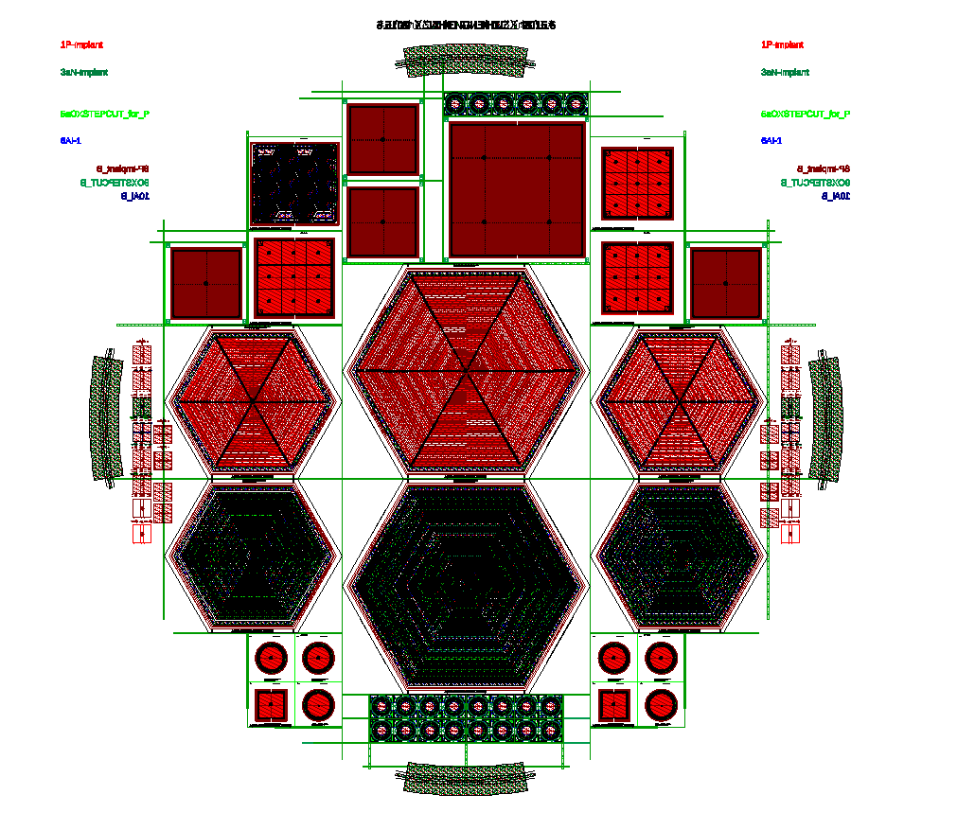
SDD Design (7 layears/Masks, douple-sided)
600 mm²
314 mm²
SDD Mask Set Design 掩膜版试验设计

Slide 24
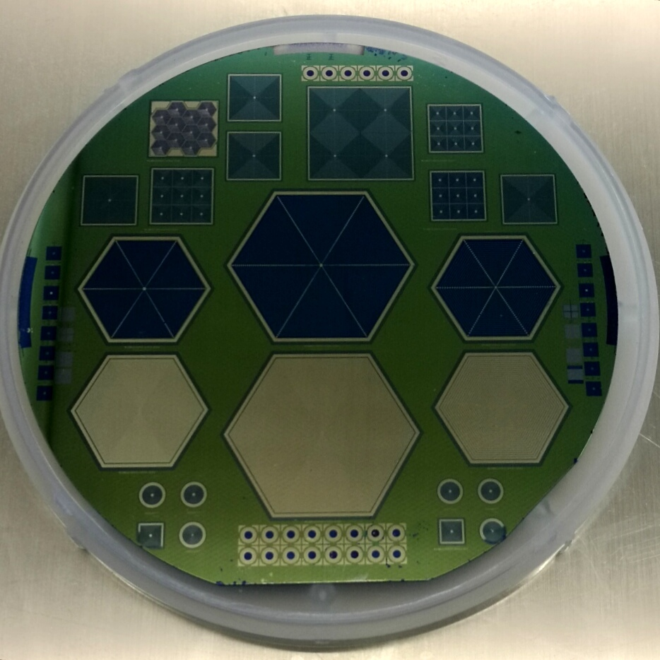
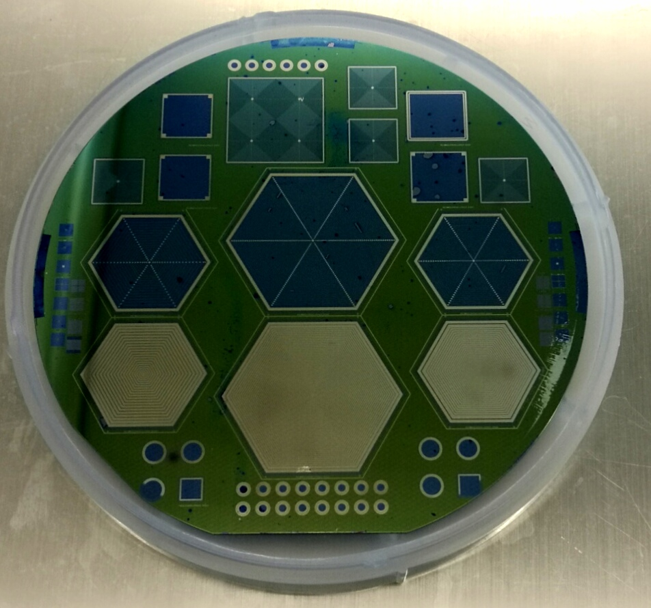
大面积硅漂移探测器）
Large area Si Drift Detectors D = 2 cm
600 mm²
314 mm²
SDD Mask Set Design掩膜版试验设计
Fabricated SDD (Top side) SDD 晶片正面
Fabricated SDD (Bottom side) SDD 晶片反面

Slide 25
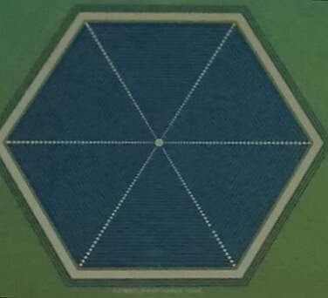
大面积硅漂移探测器）（正面）
Large area Si Drift Detectors D = 2 cm
Top-side 314mm²

Slide 26
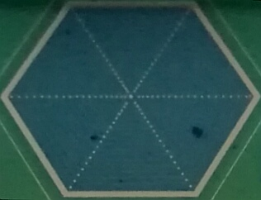
Large area Si Drift Detectors D = 2 cm
（SDD设计细节）
大面积硅漂移探测器）（反面）
Bottom-side 314mm²

Slide 27
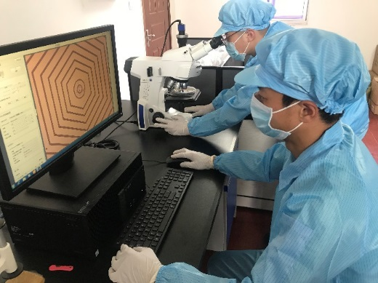
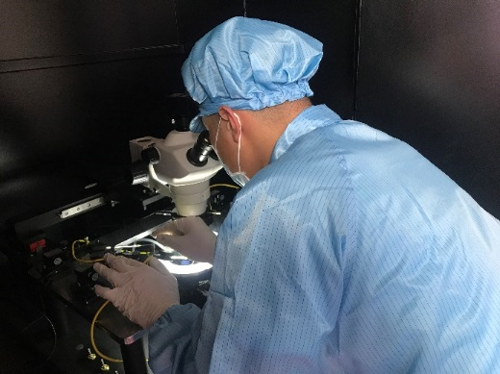
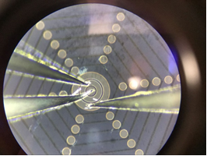
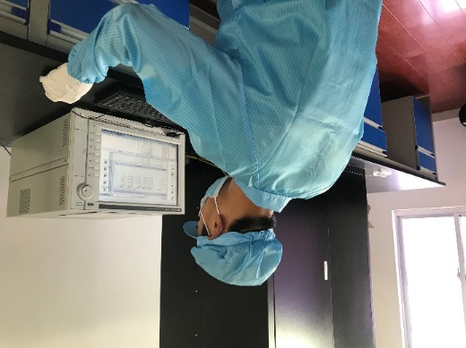
SDD Test results
探测器芯片测试技术
C - V 测试数据
Test system (Multi-I, Multi-V, Multi-Probe Station)
测试过程及操作示范 (多电流，多电压源， 多探针）
I - V 测试数据

Slide 28
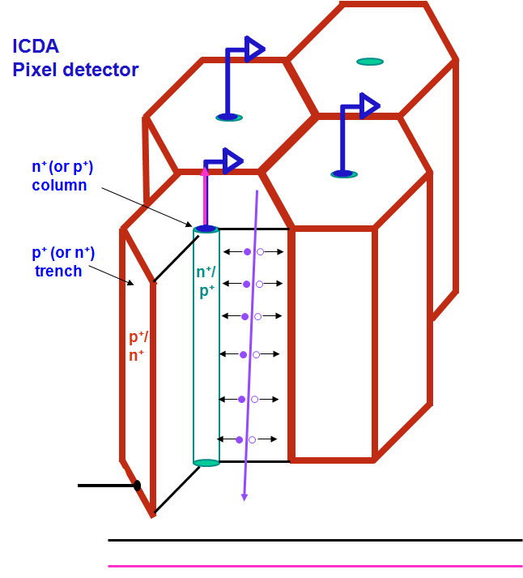
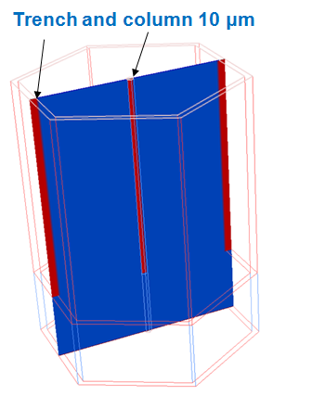
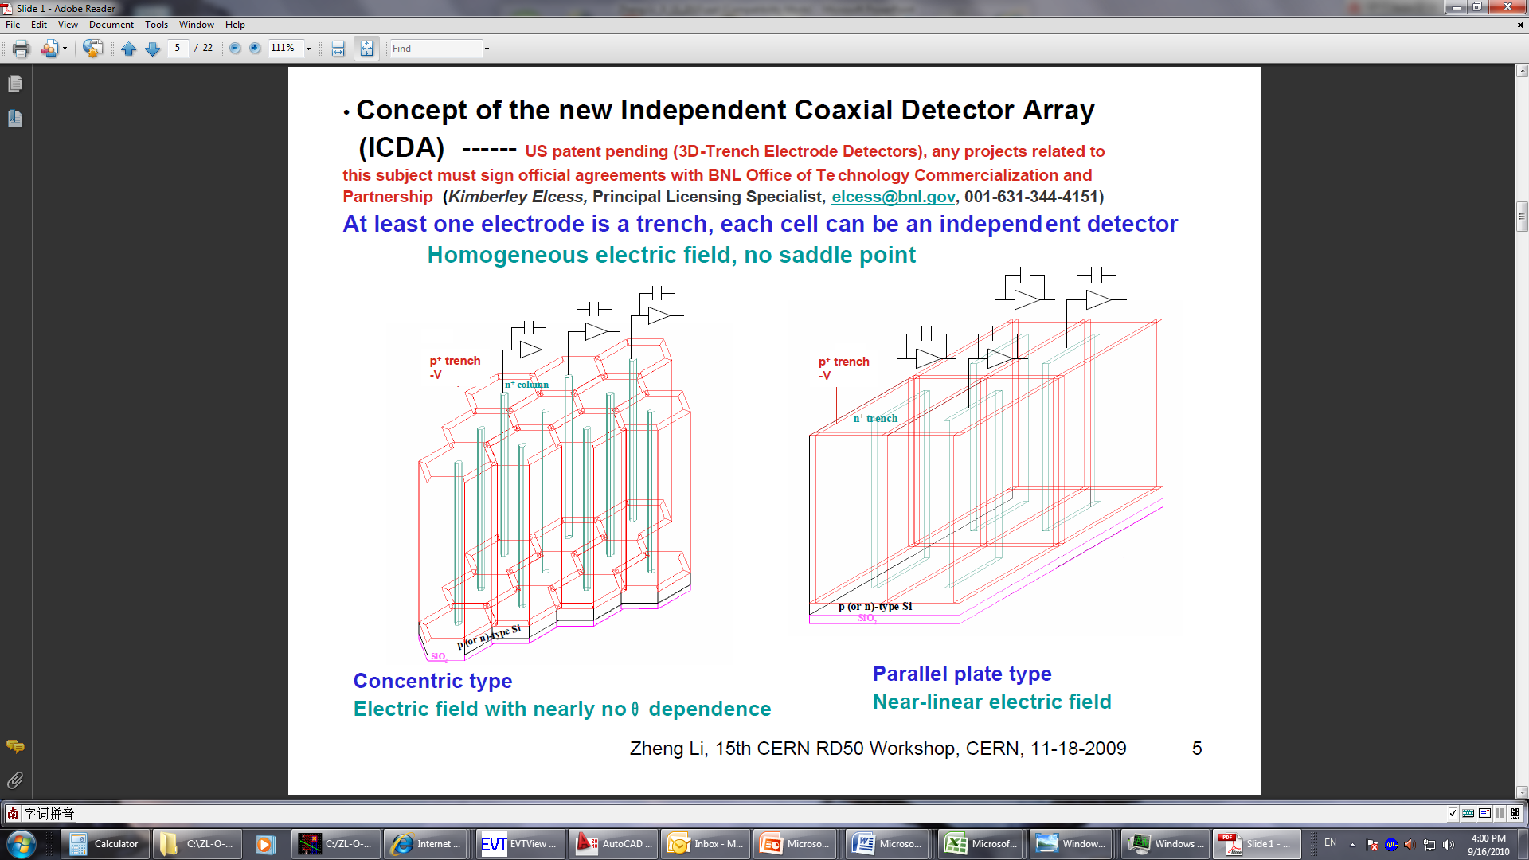
The New 3D-Trench-Electrode Detectors
Trench electrode
Collection electrode (column)
d
V
W
Full depletion voltage is small and independent on d
Pixel cells are isolated from each other --- Independent Coaxial Detector Array
(ICDA)
Depletion depth W is decoupled from the thickness d
“New BNL 3D-Trench electrode Si detectors for radiation hard detectors for sLHC and for X-ray applications”
Z. Li, Nucl. Instr. and Meth. A 658 (2011) 90–97 doi:10.1016/j.nima.2011.05.003

Slide 29
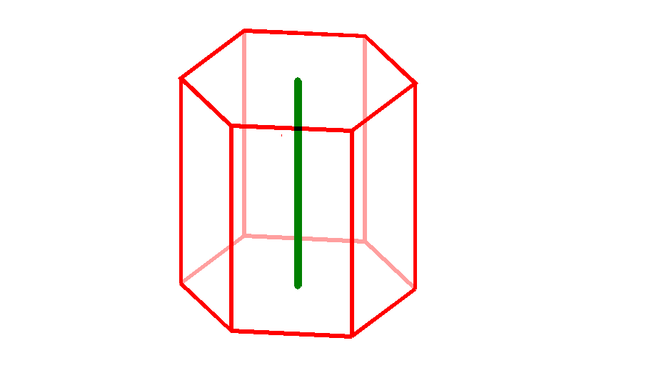
3D-Trench-Electrode Si Detectors
Q
Operation Principle
p⁺-trench
n⁺ column
d (wafer thickness)
-
-
-
-
-
-
-
-
R
hν
n-type Si
d : up to 1 mm
R : up to 500 μm
3D-processing technology
Single-metal technology, double-sided litho

Slide 30
The New 3D-Trench-Electrode Detectors
Q
Operation Principle
-
-
-
-
-
p⁺-trench
n⁺ column
-
d (wafer thickness)
-
-
-
R
-
n-type Si
d : up to 1 mm
R : up to 500 μm
3D-processing technology
Single-metal technology, double-sided litho
MIP

Slide 31
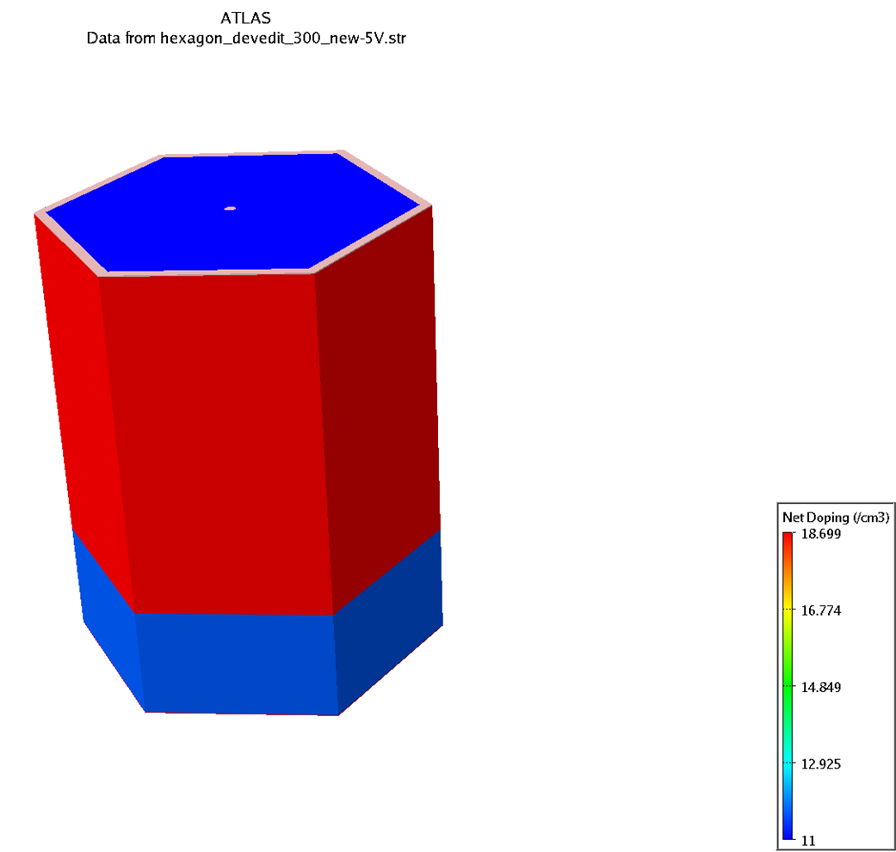
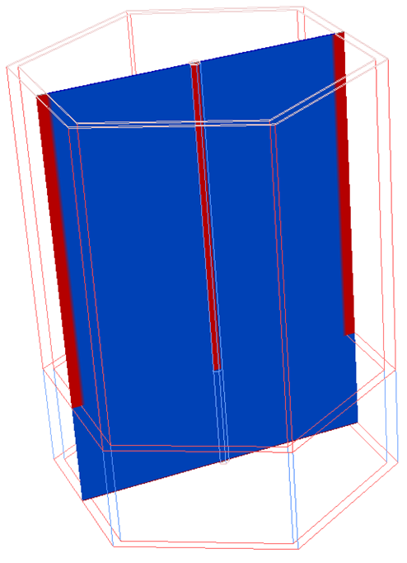
Full 3D simulations
Trench and column 10 μm wide
Hexagonal geometry (n-type column) for photon science
( R=150 µm)
Two electrodes
n⁺ column
150 μm
300 μm
3D-Trench-ORJ
p⁺ trench
b)
400 μm
n-type bulk
5x10¹¹ cm⁻³
a)
p-spray implant the back

Slide 32
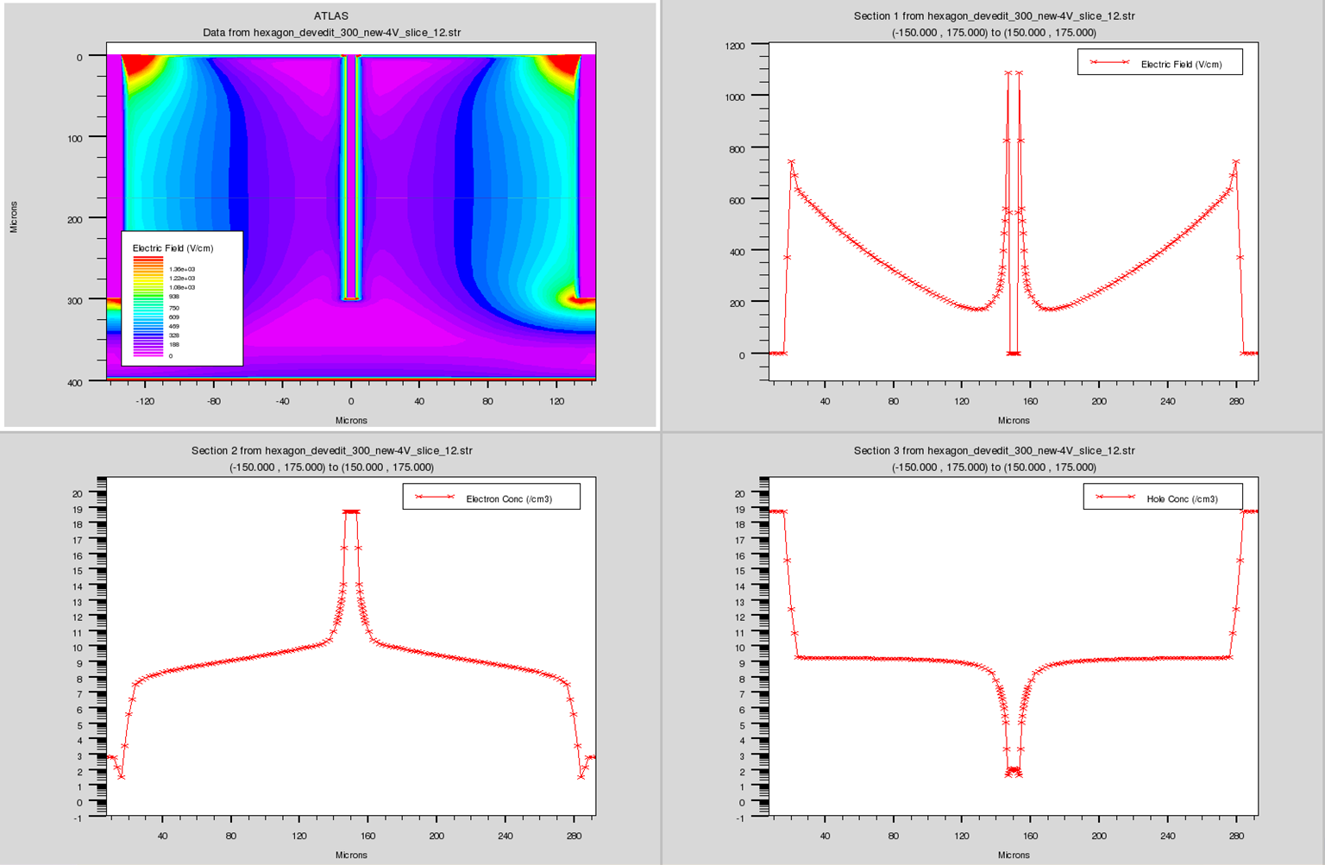
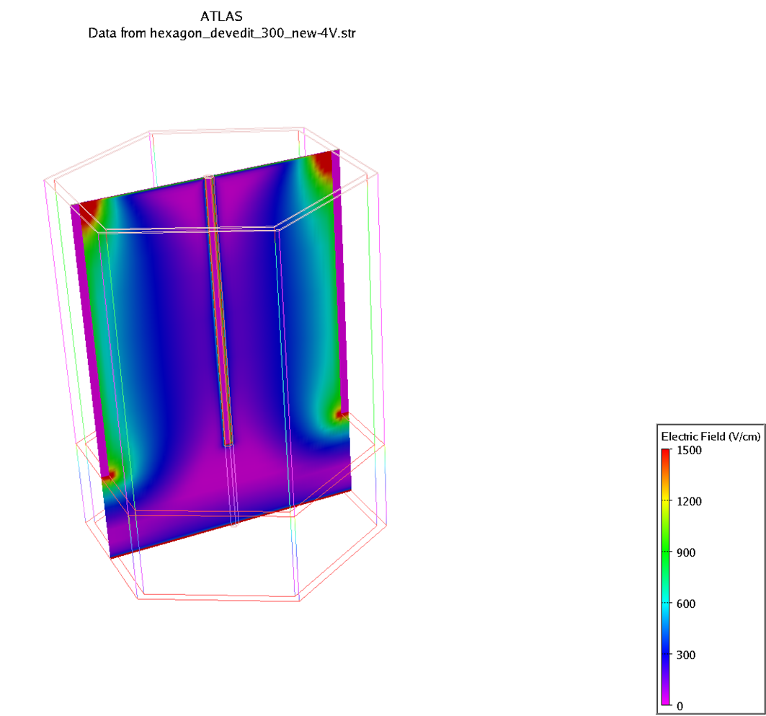
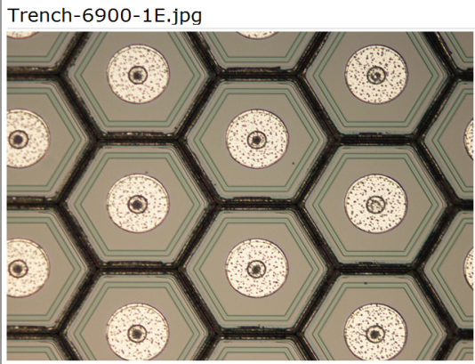
Full depletion
already at V_{bias}=4V
(d = 400 μm)
Electric Field (V/cm)
1200
1000
800
1st cut (3D 2D)
2nd cut (2D 1D)
600
400
200
0
b)
c)
Electron conc. (cm⁻³)
Hole conc. (cm⁻³)
a)
5x10¹¹
Actural 3D detecter
(D=160 μm)
f)
d)
e)

Slide 33
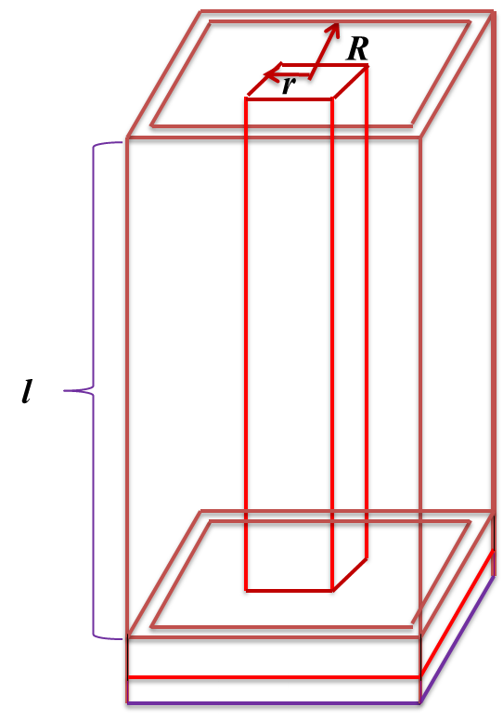
Capacitance
Simulated capacitance: C = 99 fF
Theoretical capacitance: C = 97.8 fF
l=270 μm R/r=10
Similar to SDD, it has very small capacitance, good for X-ray applications

Slide 34
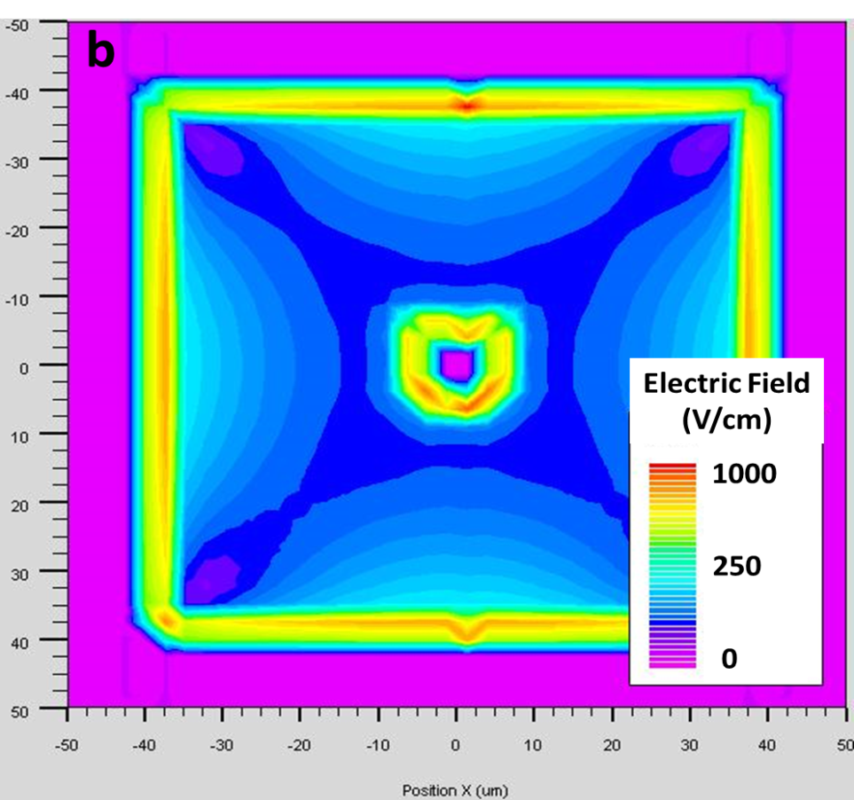
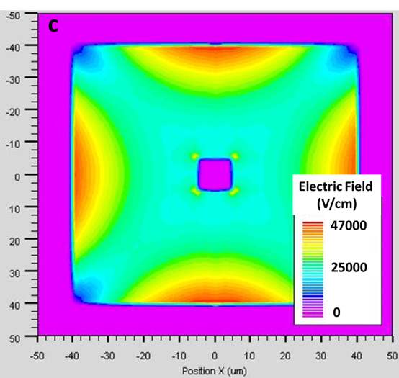
Electric field simulation
Fully depleted at
V = 1V
a
V = 100V
b
2D cross section at z=135 μm. a) electric field for non-irradiated detetor, V=1 V; b) electric field at the fluence of 1x10¹⁶ n_{eq}/cm², V=100 V.

Slide 35
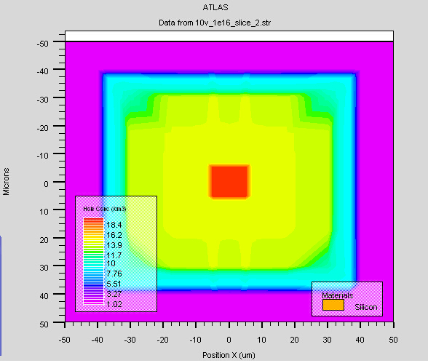
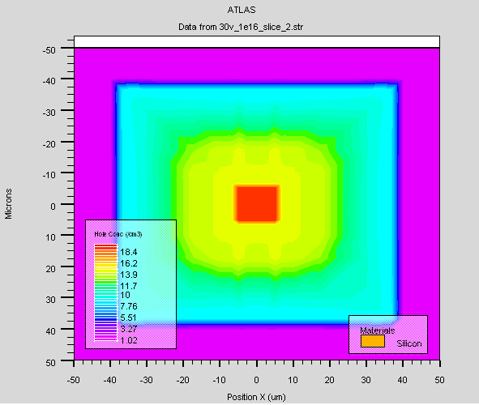
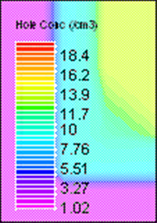
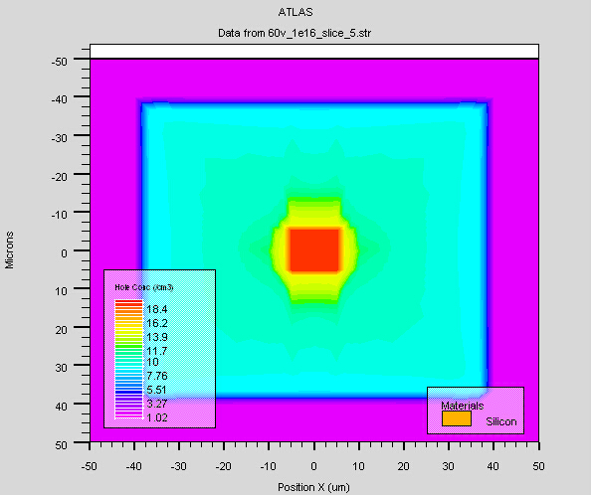
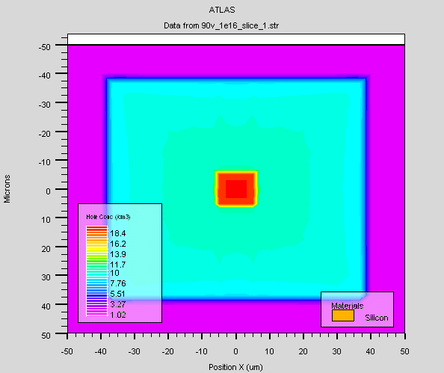
Hole concentration (depletion trend)
10 V
30 V
Hole concentration
distribution at
1x10¹⁶ n_{eq}/cm²
Full depletion
voltage is
about 90 V
For non-irradiaed
it is <1 V!
60 V
90 V

Slide 36
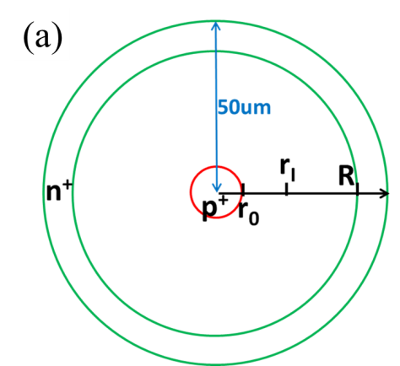


Collected charge for the non-irradiated detector
_{Very fast <1 ns}

Slide 37
Radiation hard
Collected charge for the irradiated detector
(c)
(d)

Slide 38

Fabricated detectors: One example:
Hexangular type, R = 80 μm, 49x54 array
Etched trenches
Design
Actual photos
Trenches
_{250 um depth}

Slide 39

Fabricated detectors: on 4" wafer
100 mm

Slide 40

R = 500 μm
1 mm

Slide 41

Hex, R = 80 μmc
160 μm

Slide 42

Square, L = 212 μm
212 μm

Slide 43

Leakage current test

Slide 44






Laser scan results, NYU 8/2014
20V
60V
100V
Fast
Full
Hex 02 100 um from column
Aug 8th

Slide 45



Laser scan
results, NYU
8/2014
60V
60V
100V
Hex 01
140V

Slide 46

Laser Study of 49x54 3D-Trench Electrode Detector Array
2017 results
49x54 3D-Trench Electrode Detector Array

Slide 47




Laser Study of 49x54 3D-Trench Electrode Detector Array
2017 results
Area of Detail
5
7
2
4
6
3
1
160 μm

Slide 48


Laser Study of 49x54 3D-Trench Electrode Detector Array
2017 results
View of Wire-Bonds

Slide 49
Laser Study of 49x54 3D-Trench Electrode Detector Array
2017 results
Laser Settings
Pulse Voltage: 1.56V
Pulse Width: 20nsec
Averaging: 128
Step Size: 0.01mm
Filtering Settings
High Pass
  C=22nF
  R=510Ω
Low Pass
  R=50Ω
  C=1nF
  Detector Voltage
  Bias -100V
  Guard Ring floating

Slide 50
Laser Study of 49x54 3D-Trench Electrode Detector Array
2017 results
Pixels 1 & 2
160 μm

Slide 51
Laser Study of 49x54 3D-Trench Electrode Detector Array
2017 results
Pixels 3,4,5
160 μm
160 μm

Slide 52
Laser Study of 49x54 3D-Trench Electrode Detector Array
2017 results
Pixels 6 & 7
160 μm
Good pixels separation good position resolution
Good for particle and X-ray imaging detector

Slide 53





The Detector Team at Xiangtan University
探测器模拟、设计、开发及制作的团队。

Slide 54
Summary
Large area SDD is now designed
with Φ up to 5 cm
一
研究背景
1
They can form SDD array up to 1 m²
Good for X-ray Applications
2
3
3D-Terench-Electrode Detectors has been developed
3D-Terench-Electrode Detectors are good for X-ray and high energy physics applications
4

Slide 55
Thank You！
14

Slide 56


高性能硅探测器
噪声低、功耗低、探测效率高
对比技术指标 | 传统探测器 | 高性能探测器
能量分辨率 | ≥200 eV | ~130 eV
工作电压 (漏电流相同) | 100 V | ~4 V
抗辐射效率 | 5% (10¹⁶ n/cm²) | ≥25% (10¹⁶ n/cm²)
收集时间 | ~5 ns | ~50 ps
面积 | 25 mm² | 30 cm²
三维沟槽电极硅探测器
国际首次提出
基于SOI的高阻硅CMOS MAPs探测器
填补国内空白
超大面积硅漂移室探测器
国际首次提出
6

Slide 57
高性能硅探测器的重大需求
医疗设备和医学检测（约10亿元/年）
湖南益阳正在筹建的核电站
核工业核探测（约5亿元/年）
新一代同步光源（约5亿元/年）
航天器导航系统（约40亿元/年）
目前国内高性能探测器全部依赖进口，涉及到国防及空天领域的高性能探测器国外对我国实施严格控制或禁运。高性能探测器的技术空白已经严重制约了我国国民经济的发展，威胁到我国国防安全！
7

Slide 58

湘潭大学半导体粒子光子探测器中心 （2015年底建成）

Slide 59
湘潭市高新区超纯高阻硅探测器项目 （2016年6月建成）
门
N
窗
6.3m
6.3m
3.925
3.925
3.925
3.925
2
3
2.5
1.5
4.0
更衣室
1.5
超声波圆片清洗机
通风厨
低温等离子体化学气相沉积(LPCVD)二氧化硅系统
3.5
2
6.5
风淋室
4
3
职工活动室
2
1
3.0
甩干机
1
3.5
2
等离子体增强化学汽相沉积(PECVD)多晶硅系统
3.0
7.85
7.85
15
18m
3.0
7.0
2
5.7
玻璃门
激光直刻机
2
双面光刻机
五百级
百级
2
2
甩干机
双面光刻机
3.8
1
8.5
职工休息室
3
2
金相显微镜
1
1.5
2
2
3
通风橱
通风橱
1.2
2
1
2.5
2
4
深反应离子刻蚀机
2
2
1.5
2
3.0
shower
2
晶片工作台
氧化炉
净水系统
楼 梯
1.5
2.5
2.5
1.5
6.5
8
坐便器
7
8.7
8
47.4m

